Slide 1


Brewing in Pyrmont
Prepared for The Pyrmont Historical Society, Nov 2019
Kev Staunton-Lambert Head Brewer PyrmontBrewery.com.au

Slide 2
Quick history of beer in Pyrmont
Brewing = Beer = Pyrmont
Beer drinking in the pub has been central to working class Pyrmont in the truest sense of the word ‘Public House’ since earliest days
Pubs were shared spaces on literally every street corner because of the small houses

Slide 3
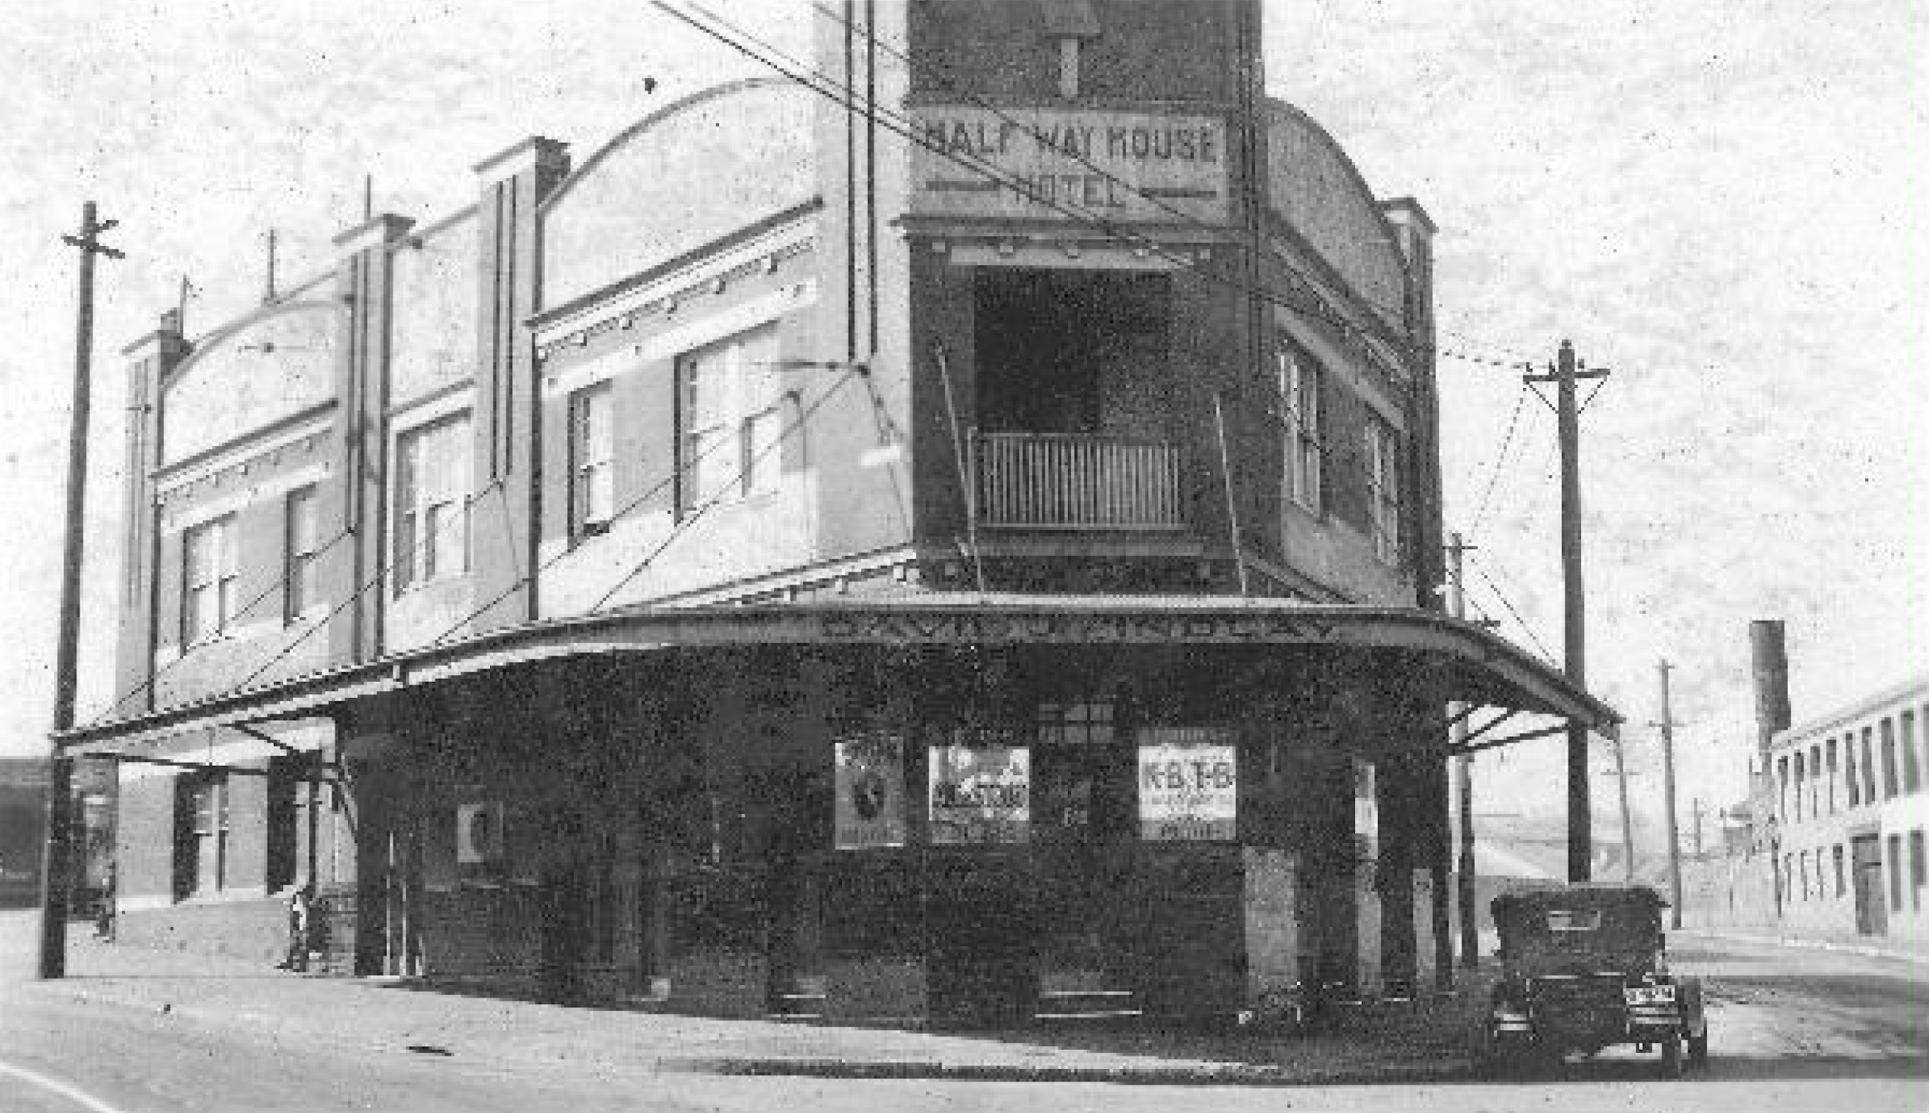
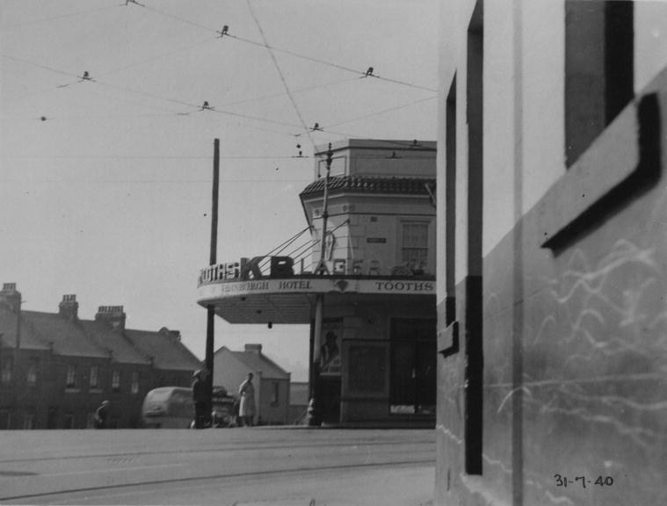
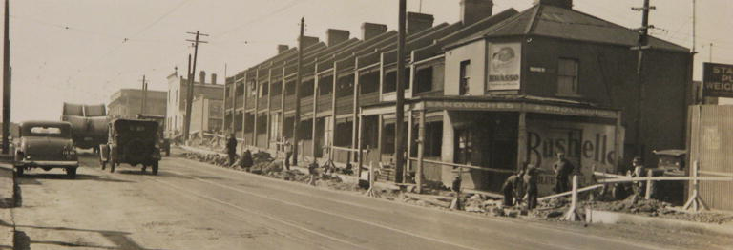
The public houses on Miller Street Pyrmont
Harlequin and Half Way House (also Gallon and others not far)
Harlequin
(Edinburgh)
Pyrmont Brewery
Half Way House

Slide 4
Unlikely, but possibly first beer in Pyrmont
James Squire was the first to brew beer in the in 1790 (14km away from Pyrmont by boat)
He was certainly the first to get hops to grow
John Boston may have beat him to first commercial sale, but was corn based beer rather than barley and hops we know today, so James wins IMO as that’s legendary!

Slide 5
History of alcohol production in Pyrmont
The Colonial Sugar Refining Company we know distilled spirit methylated alcohol, (probably some rum) but to my knowledge the Pyrmont Brewery is actually the first in Pyrmont to brew traditional beer from barley malt grain and hops that won’t make you go blind! Well, no reported blindness in 12 years (brewery established early 2007)

Slide 6
History of brewing near Pyrmont
Obviously the Lord Nelson (Rocks) needs a honorary mention, on-site brewing since 1986
+ fair number of newer breweries in order of distance from Pyrmont… All Hands (Darling Harbour), Staves (Broadway), Redline (Tramsheds), Wayward and Malt Shovel (Camperdown), The Surry Hills and Redoak

Slide 7
What’s actually involved in brewing beer?
Step 1 Find Grain (grow and malt some barley)
Step 2 Mash it (convert starches to sugar)
Step 3 Lauter (remove grain/sparge to get wort)
Step 4 Boil wort with hops (kills bad enzymes)
Step 5 Ferment with yeast (= ethanol + co2)
Step 6 Wait for a bit, drink it, rinse and repeat

Slide 8
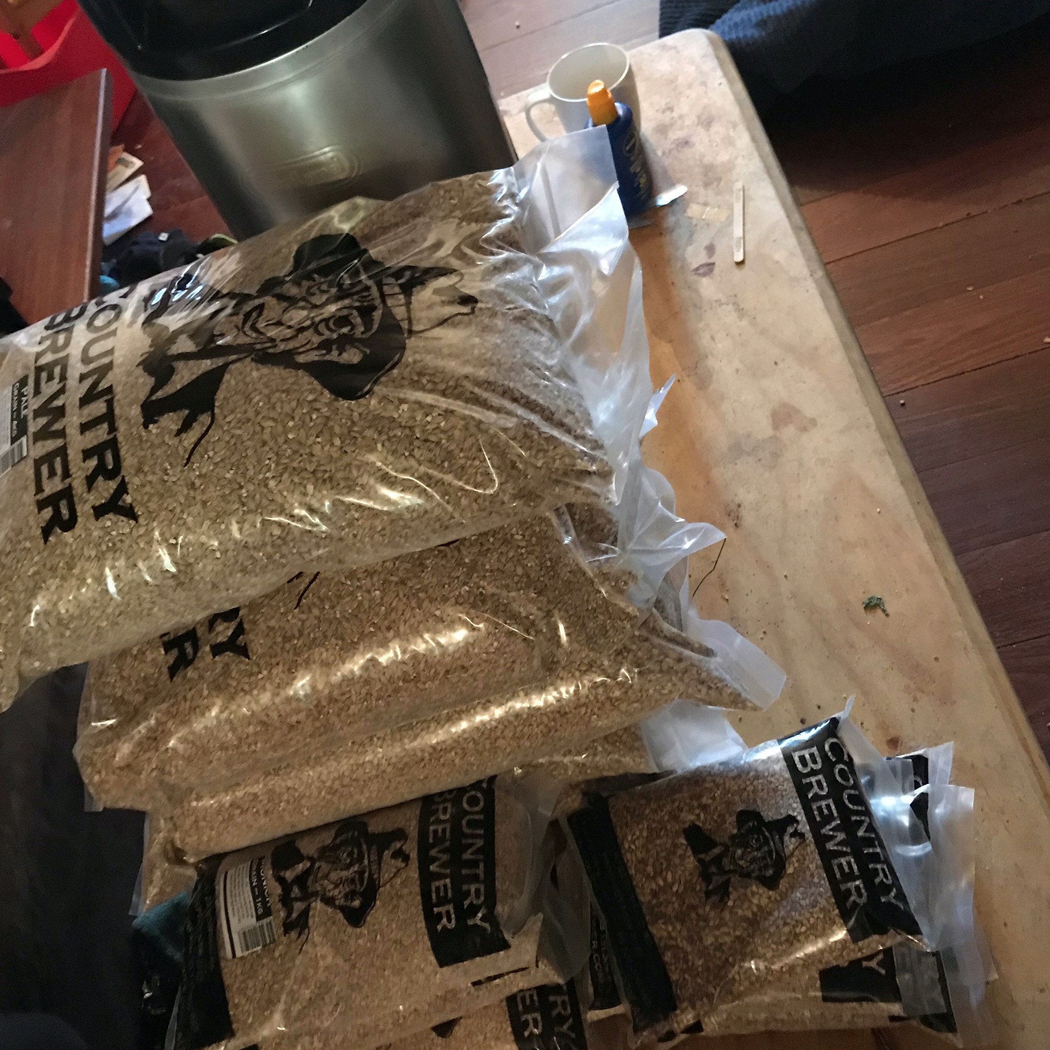
Step 1 - Find Grain - today thats easy
Though you need lots of it!
Typical 50L Commercial keg ~ 12kg grain Consider this in Colonial days...

Slide 9
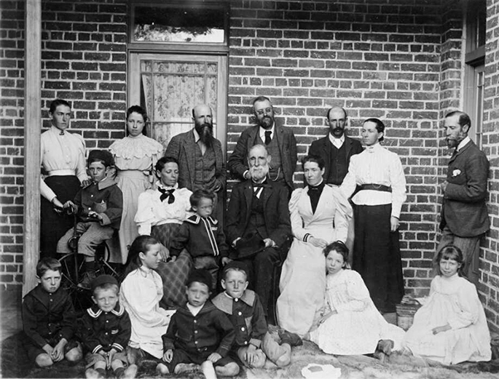
Step 1 - Grain - providers in 1800s Australia
Many others, but these guys, the De Salis + William Farrer
Farrer was first to cross-breed Wheat to make it hardier to disease

Slide 10
Grain - Colonial grain - Varieties
Not a great deal of choice in colonial barley growing, most likely would have come from England, which likely means Pioneer (the brewery in Orange actually grows that today)
Mittagong, NSW was the first Maltings
Today we talk about bulk/base and speciality malts. Malts are roasted germinated grains

Slide 11
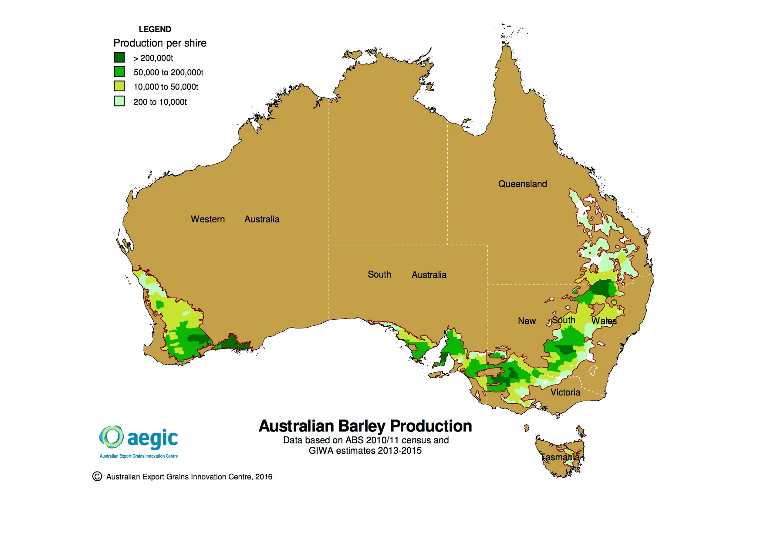
Grain - Base malts produced in Australia today
Common base malts grown and malted in Australia - note majority barley is animal feed not diastatic malt Pale (2+6 row) Pilsner Ale Vienna Munich

Slide 12

Grain - Specialties grown/imported in Australia
Heaps! Different varieties, mostly roast times Few diastatic Chocolate Carahel Aciduated Crystal Patent Black … many ...

Slide 13
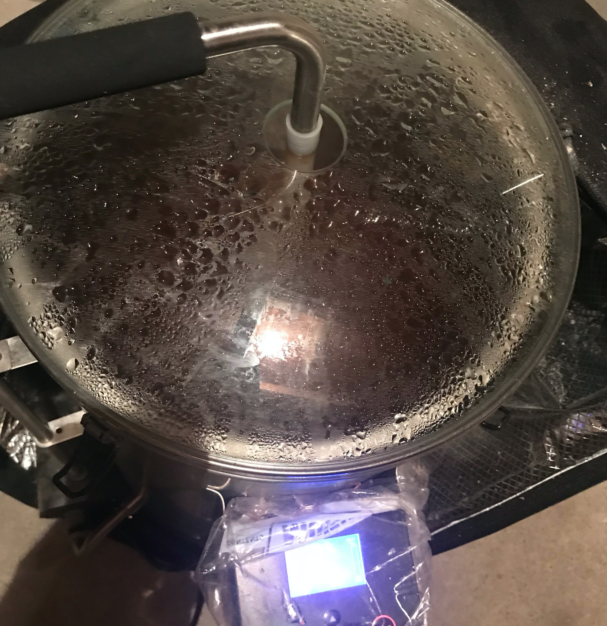
Step 2 - Mash
Mashing is wetting then holding the grain at various temperatures for enzymes to convert starches into sugars - different grains and beer styles have mash steps
Ale typically 67C for 1 hour
Pilsner 51C for 30m then 67C
Lots of variations + flavours...

Slide 14
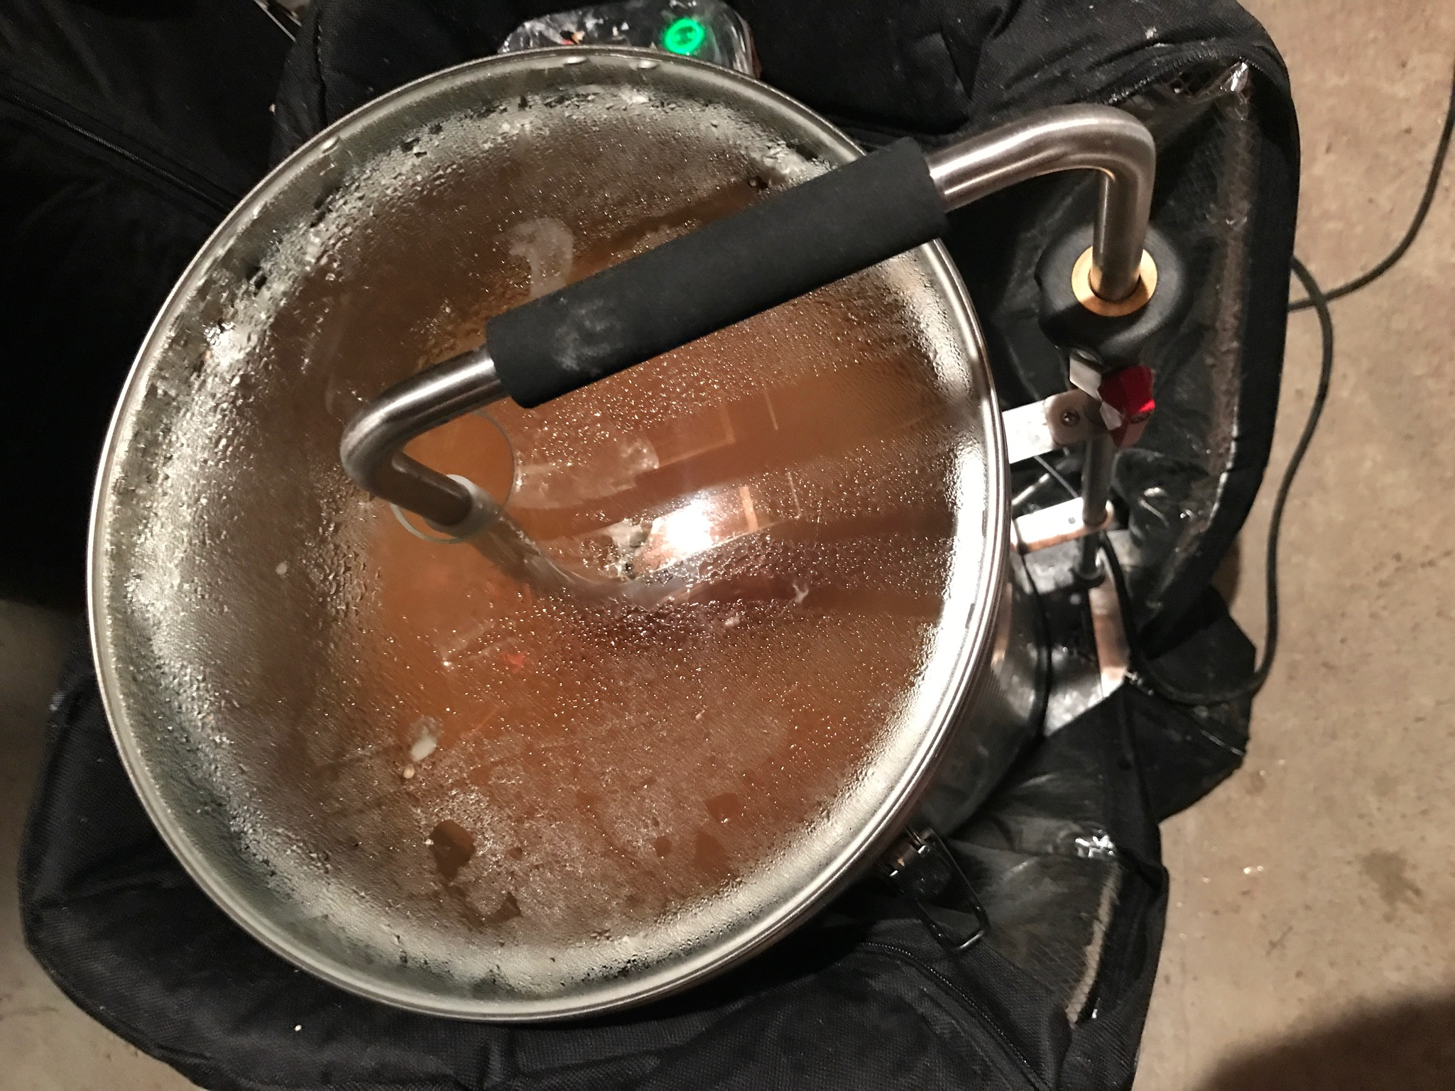
Step 2 - Mash
Thats, 51C for 30min then 67C for 30min
Most grains then need a mash out at 75C to avoid diacetyl (bad esters) being released
In 1790’s Sydney, how?!
Like I said, Squire was an absolute legend!
(this by the way is how its done today - this is bluetooth computer controlled with thermocouple)

Slide 15
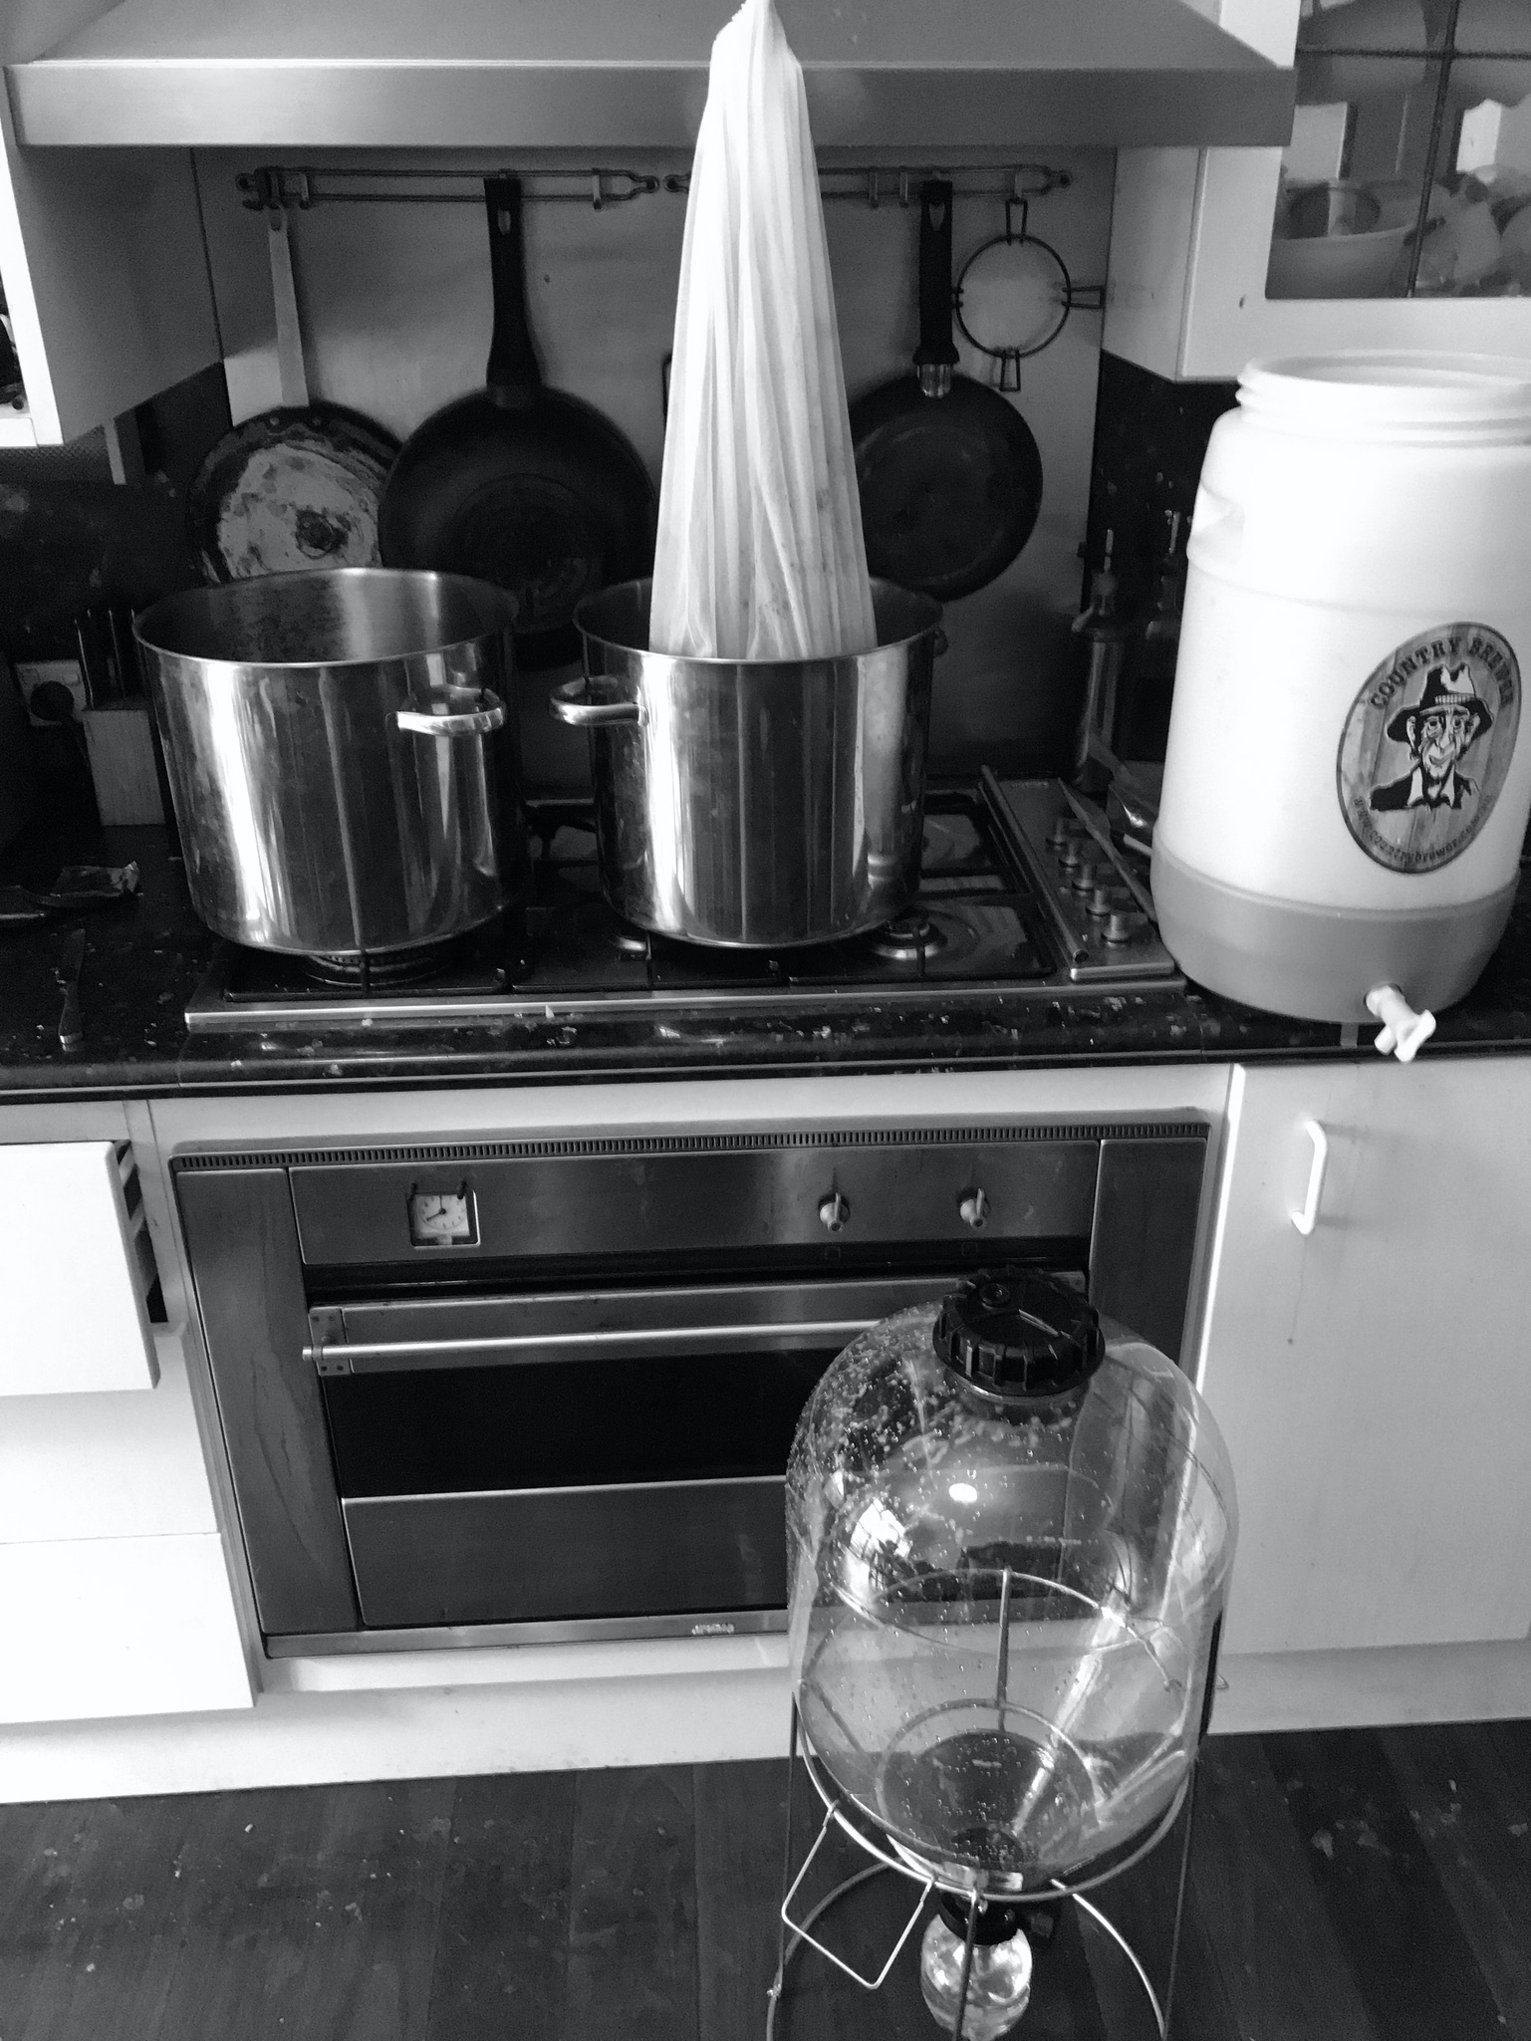
Step 3 - Lauter / Sparge
Removing the grain to leave wort (‘wert’)
Large tanks used in larger breweries which sift the grain away, small scale you can just lift it out
Then gently (very gently) wash the grain, typically at 75C to about 115%

Slide 16
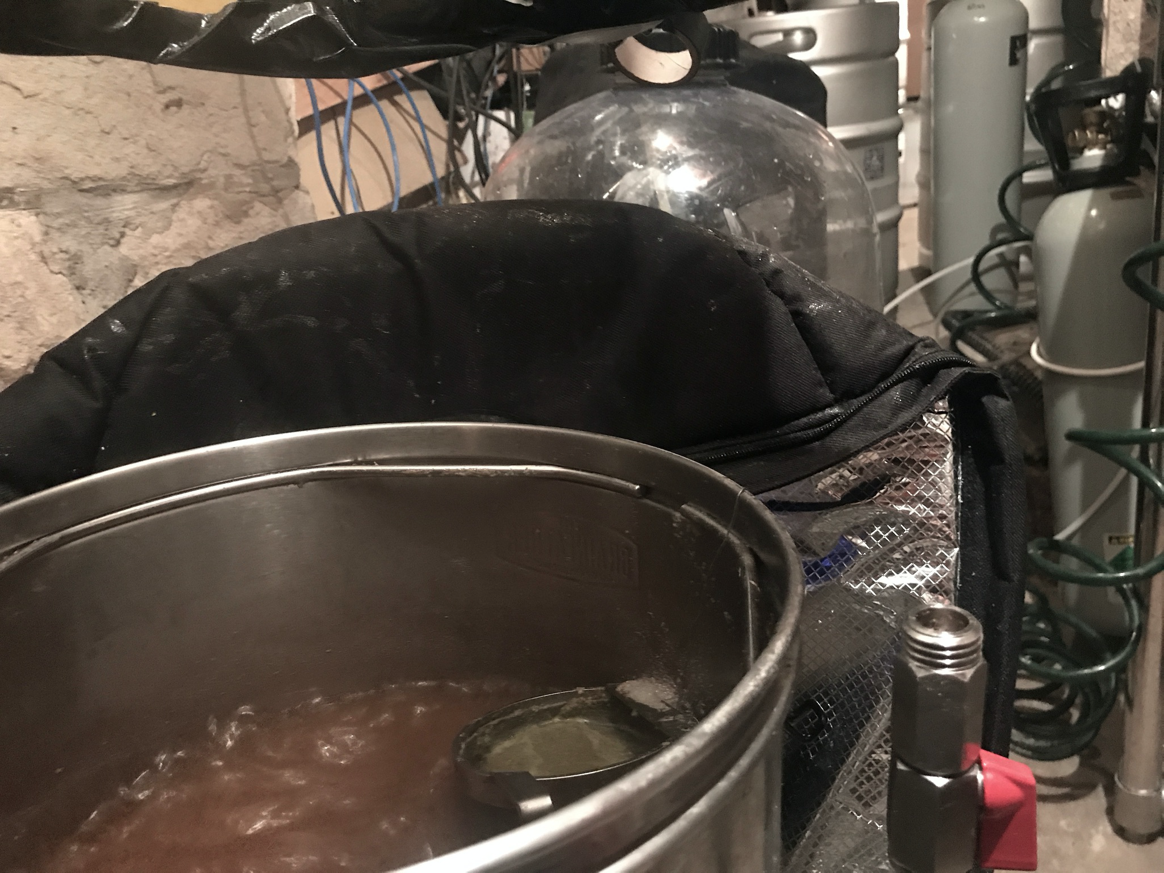
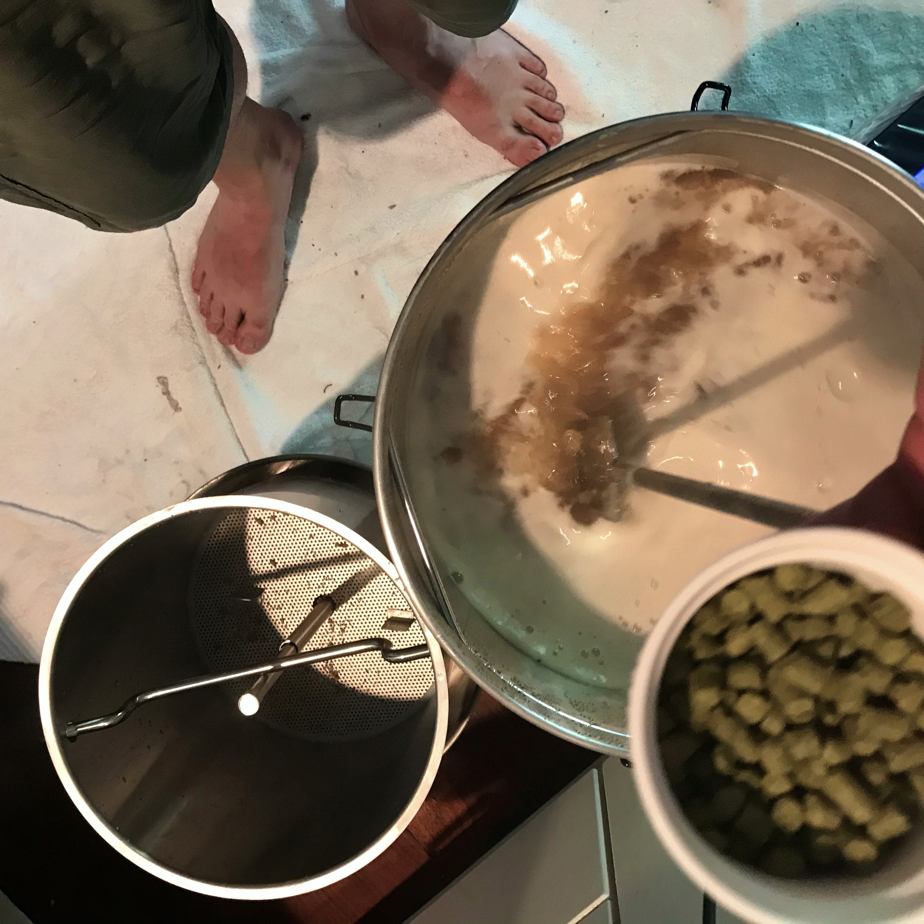
Step 4 - Boil
Literally hard boil at 100C (no less) for an hour to 1 1/2 hours (hence the extra 15%)
Hops added at various stage Bittering hops at the start + often in the middle boil
Aromatic hops at the end

Slide 17

Step 4 - Boil + Hops
Many types of hop, great Aussie and NZ ones
Bittering Hops
Admiral, Agnus, Apollom, Banner, Bitter Gold, Bravo, Brewer’s Gold, Bullion, California, Cluster, Chelan, Comet, Eastern Gold, Eroica, Feux-Coeur, Galena, Kitamidori, Magnum, Millennium, Newport, Outeniqua,Pacific Gem, Pacific Sunrise, Pilot, Pride of Ringwood, Satus, Sorachi Ace, Southern Brewer, Southern Star, Sovereign, Summit, Super Pride, Symphony, Tillicum, Toyomidori, Warrior, Yakima Cluster, Zenith, Zeus
Aromatic Hops
Ahil, Ahtanum, Amarillo, Amethyst, Aquila, Aramis, Atlas, Backa, Bianca, Blato, Blisk, Boadicea, BOR, Bramling, Canadian Redvine, Canterbury Whitebine, Cascade Cekin, Celeia, Cobb, Columbia, Crystal, Dana, Defender, Density, Dunav, Early Bird, Early Green, Early Prolific, Early Promise, East Kent Golding, Eastern Green, Eastwell Golding, El Dorado, Ella, Elsaesser,Equinox, First Choice,Fuggle, Furano Ace, Gargoyle, Golden Star, Golding,Groene Bel,Hallertau, Hallertau,Helga,Hersbrucker,Red-Stem,Hüll Melon,Hybrid-2,Ivanhoe,Janus,Jester,Keyworth’s Early,Keyworth’s Midseason, Kohatu, Landhopfen, Liberty, Lubelska, Lubelska-Pulawy, Lucan, Mandarina Bavaria, Mathon, Motueka,Mount Hood,Mount Rainier,Nadwislanska,Nelson Sauvignon Nordgaard,Olympic,Omega,Pacific Jade,Pacifica,Palisade®,Petham Golding,Pocket Talisman,Precoce de Bourgogne,Premiant,Progress,Record,Red Earth,Riwaka,Saaz, Santiam,Saphir,Saxon,Serebrianka,Shinshuwase,Sladek,Sonnet,Spalt,Spalter … (lots and lots more!)

Slide 18
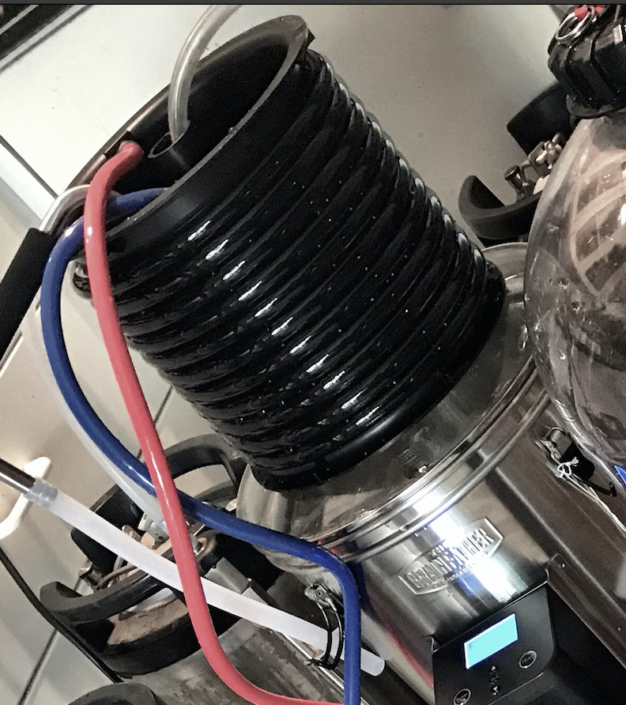
Step 5 - Cool and Oxygenate
Yeast is very fickle about temperature, fermenting in Pyrmont can be tricky in depths of winter and heights of summer
Saison yeast happy at 28C fast (5 days) - Ales 18-22C is ok (takes 10 days) - Lager flat out dies outside 8-12C (and takes 3 months) All modern yeasts - how did James Squire manage to do all this?

Slide 19
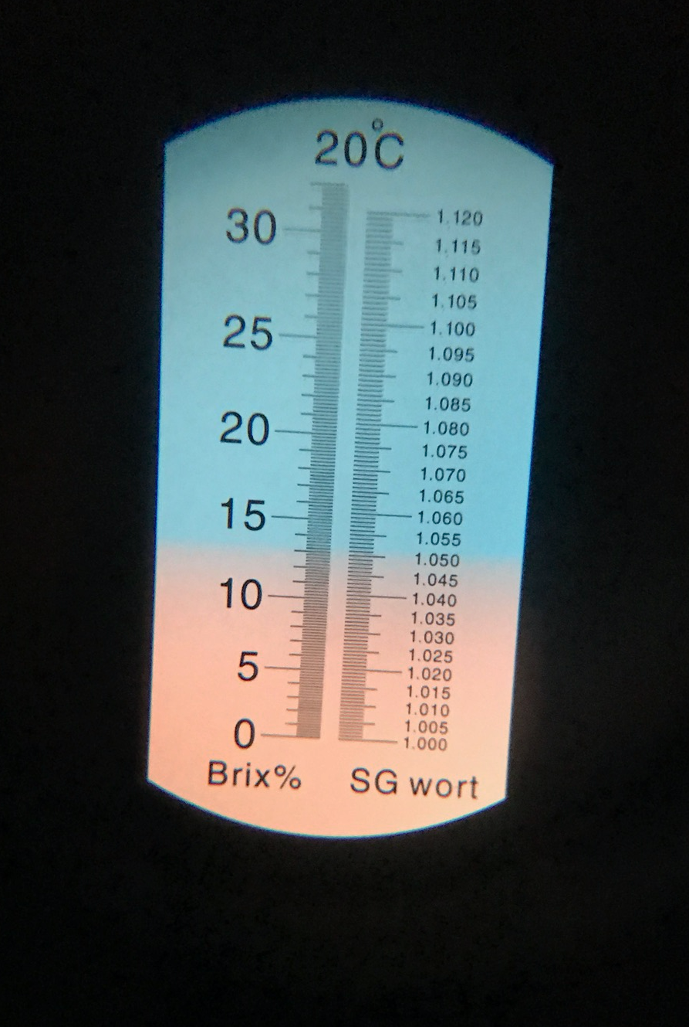
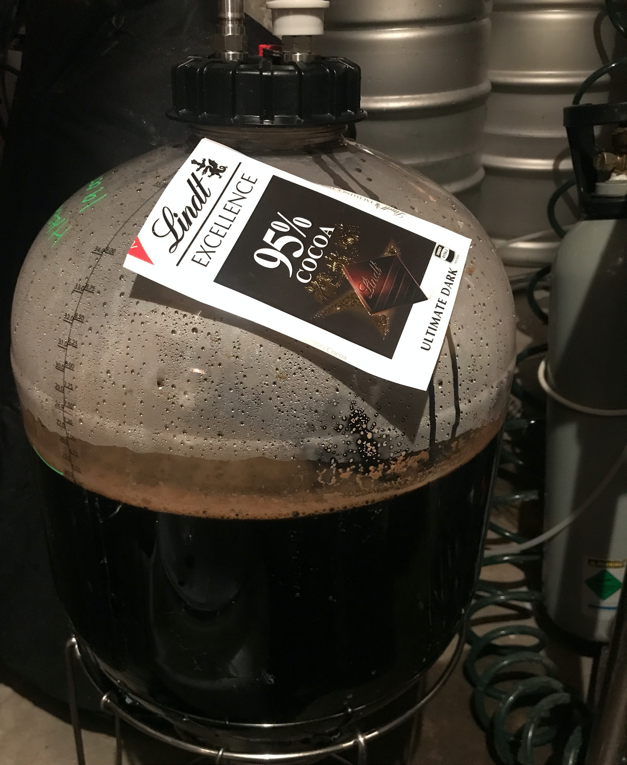
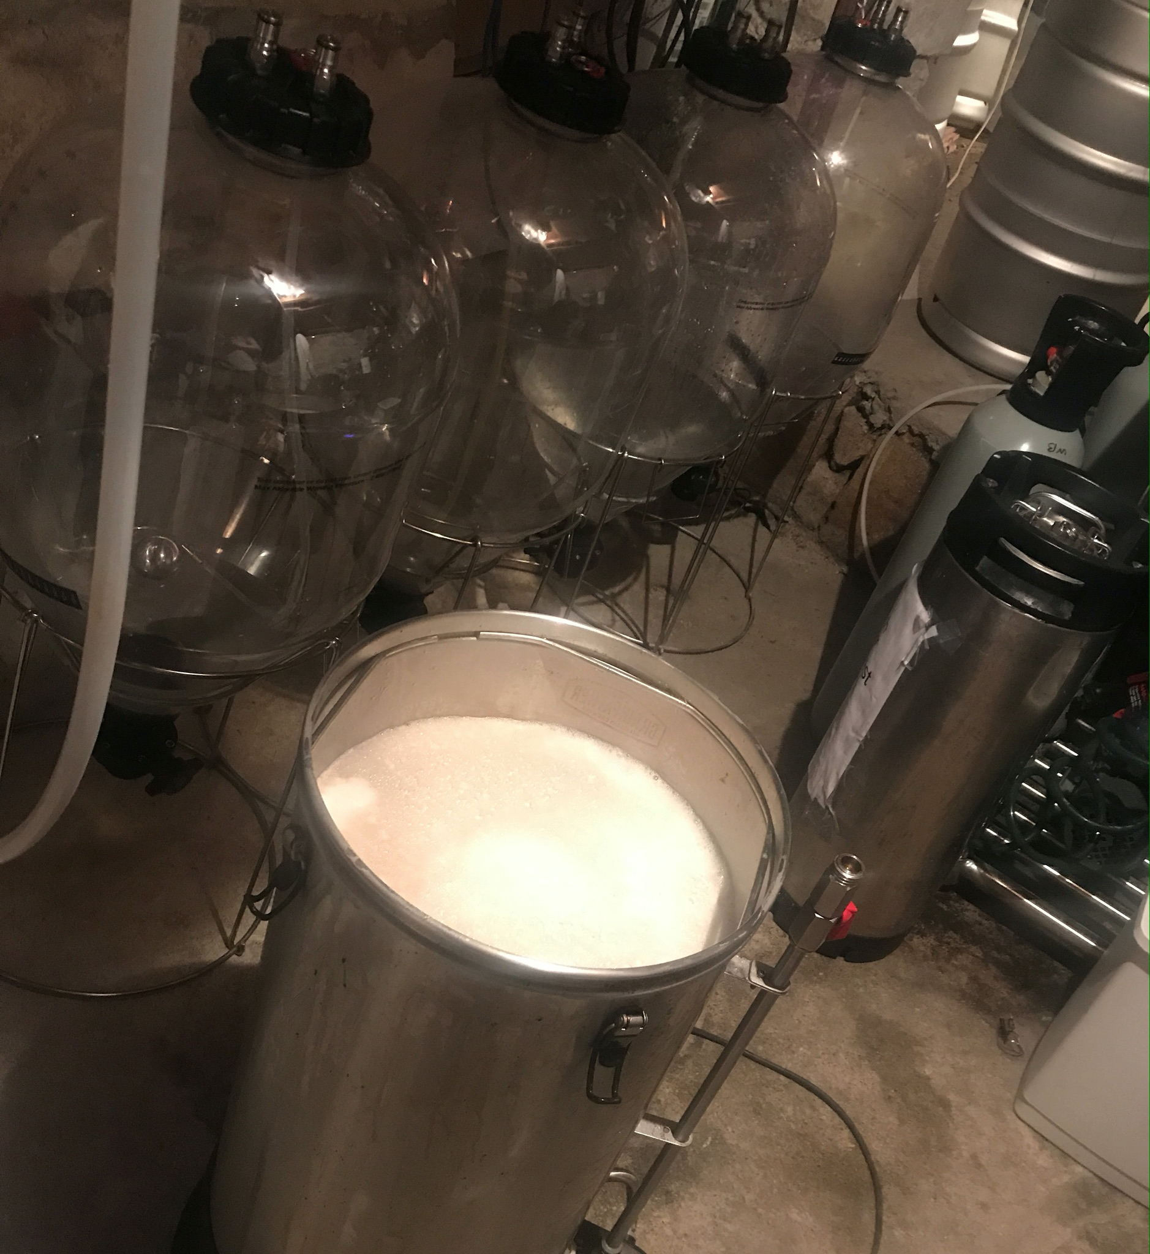
Step 5 - Ferment
This is Pyrmont Half Way House Chocolate Stout (yes has real Swiss Lindt in it)
Gravity is 1.050 (light bends in a sugar solution)

Slide 20
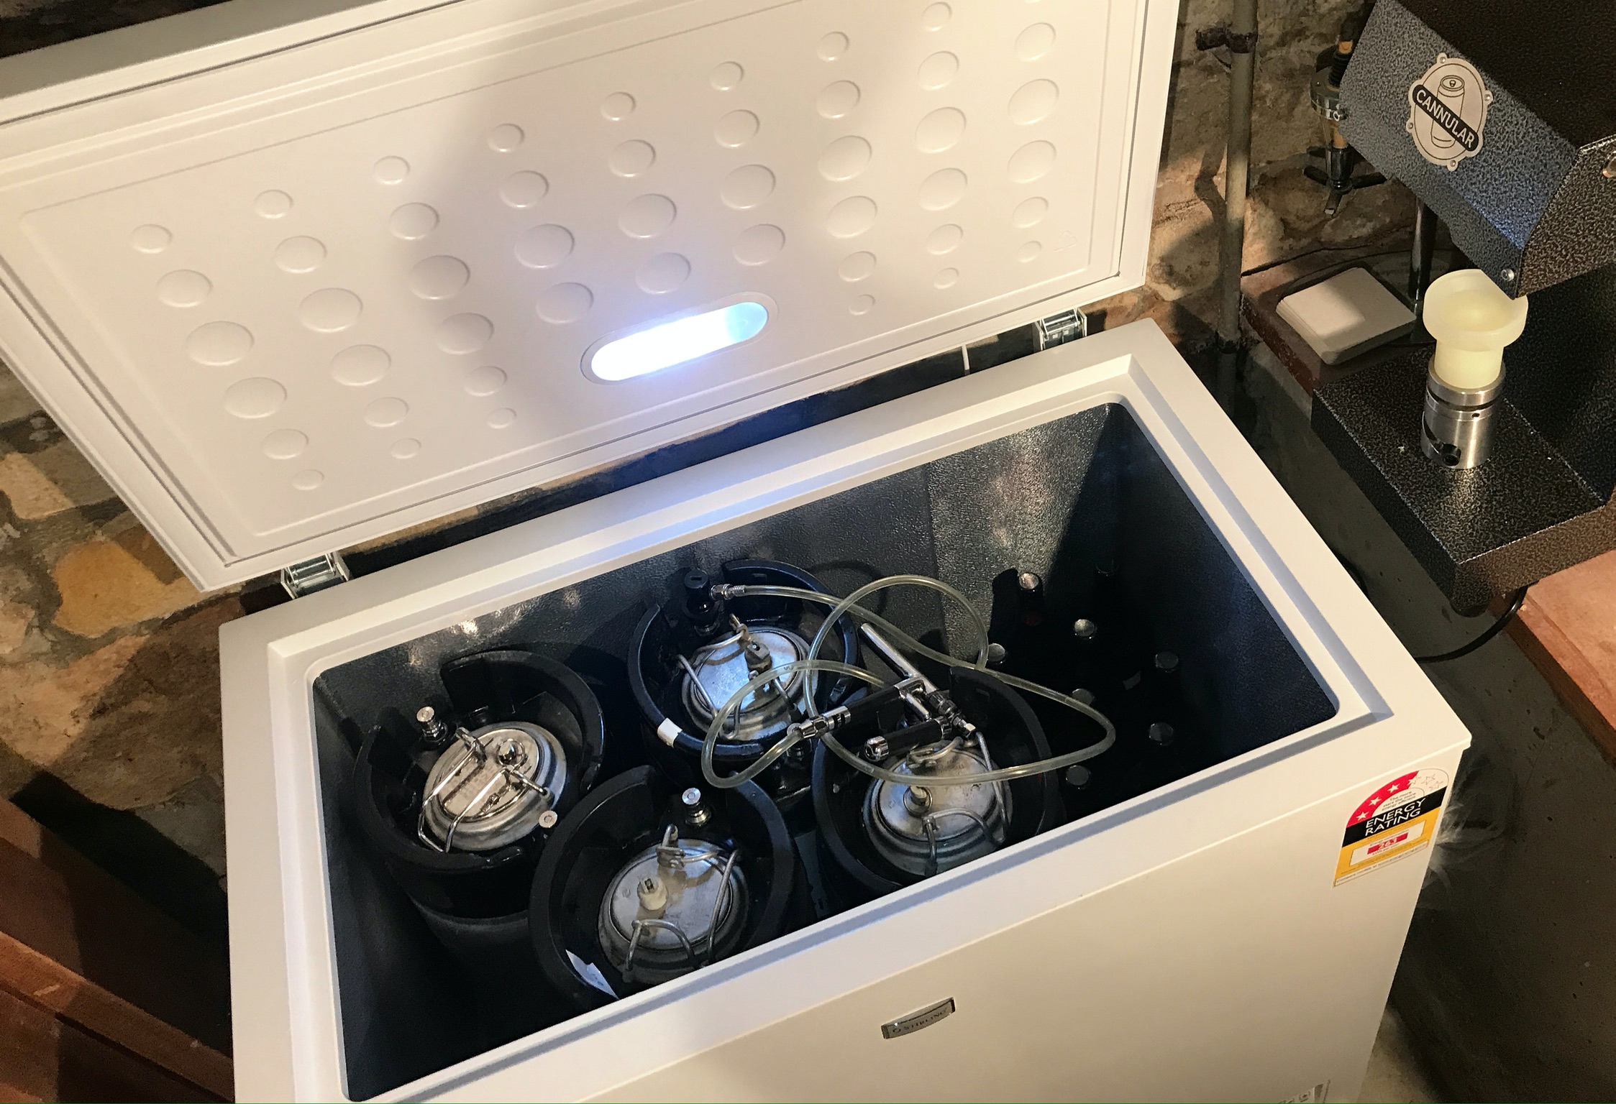
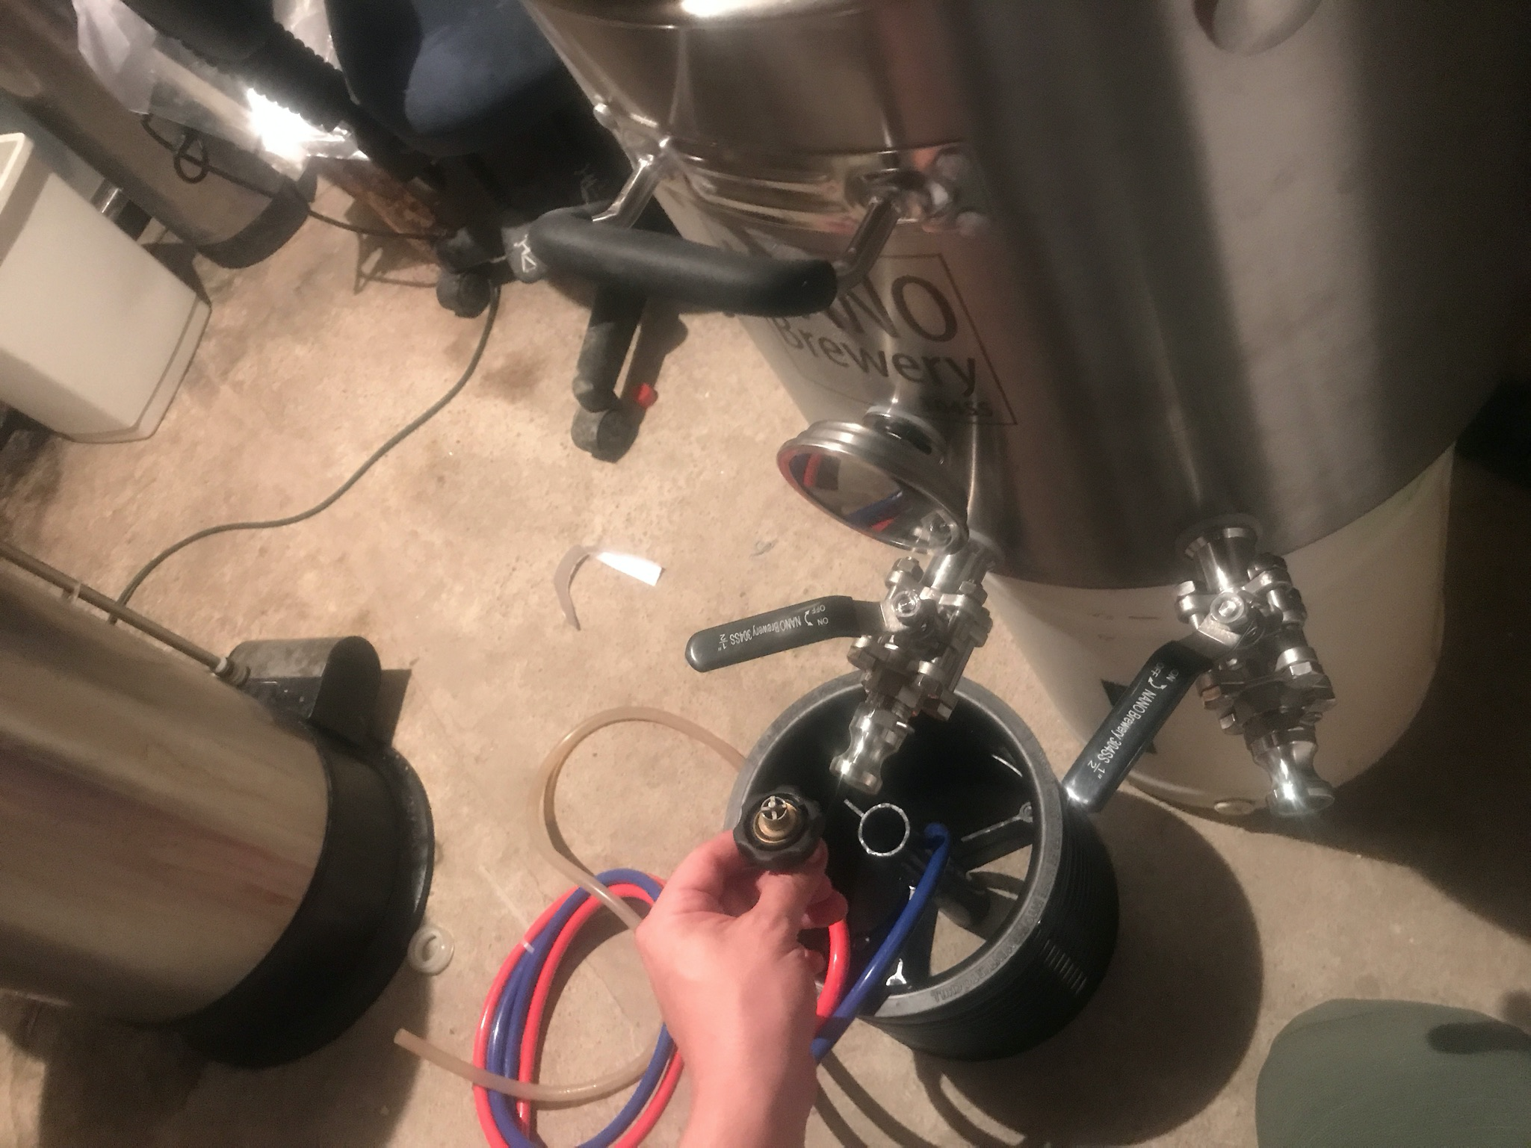
Step 6 - Racking and Waiting
Beers often take weeks to condition and become ‘bright’
Oktoberfest Märzens traditionally are made in April! … time to clean

Slide 21
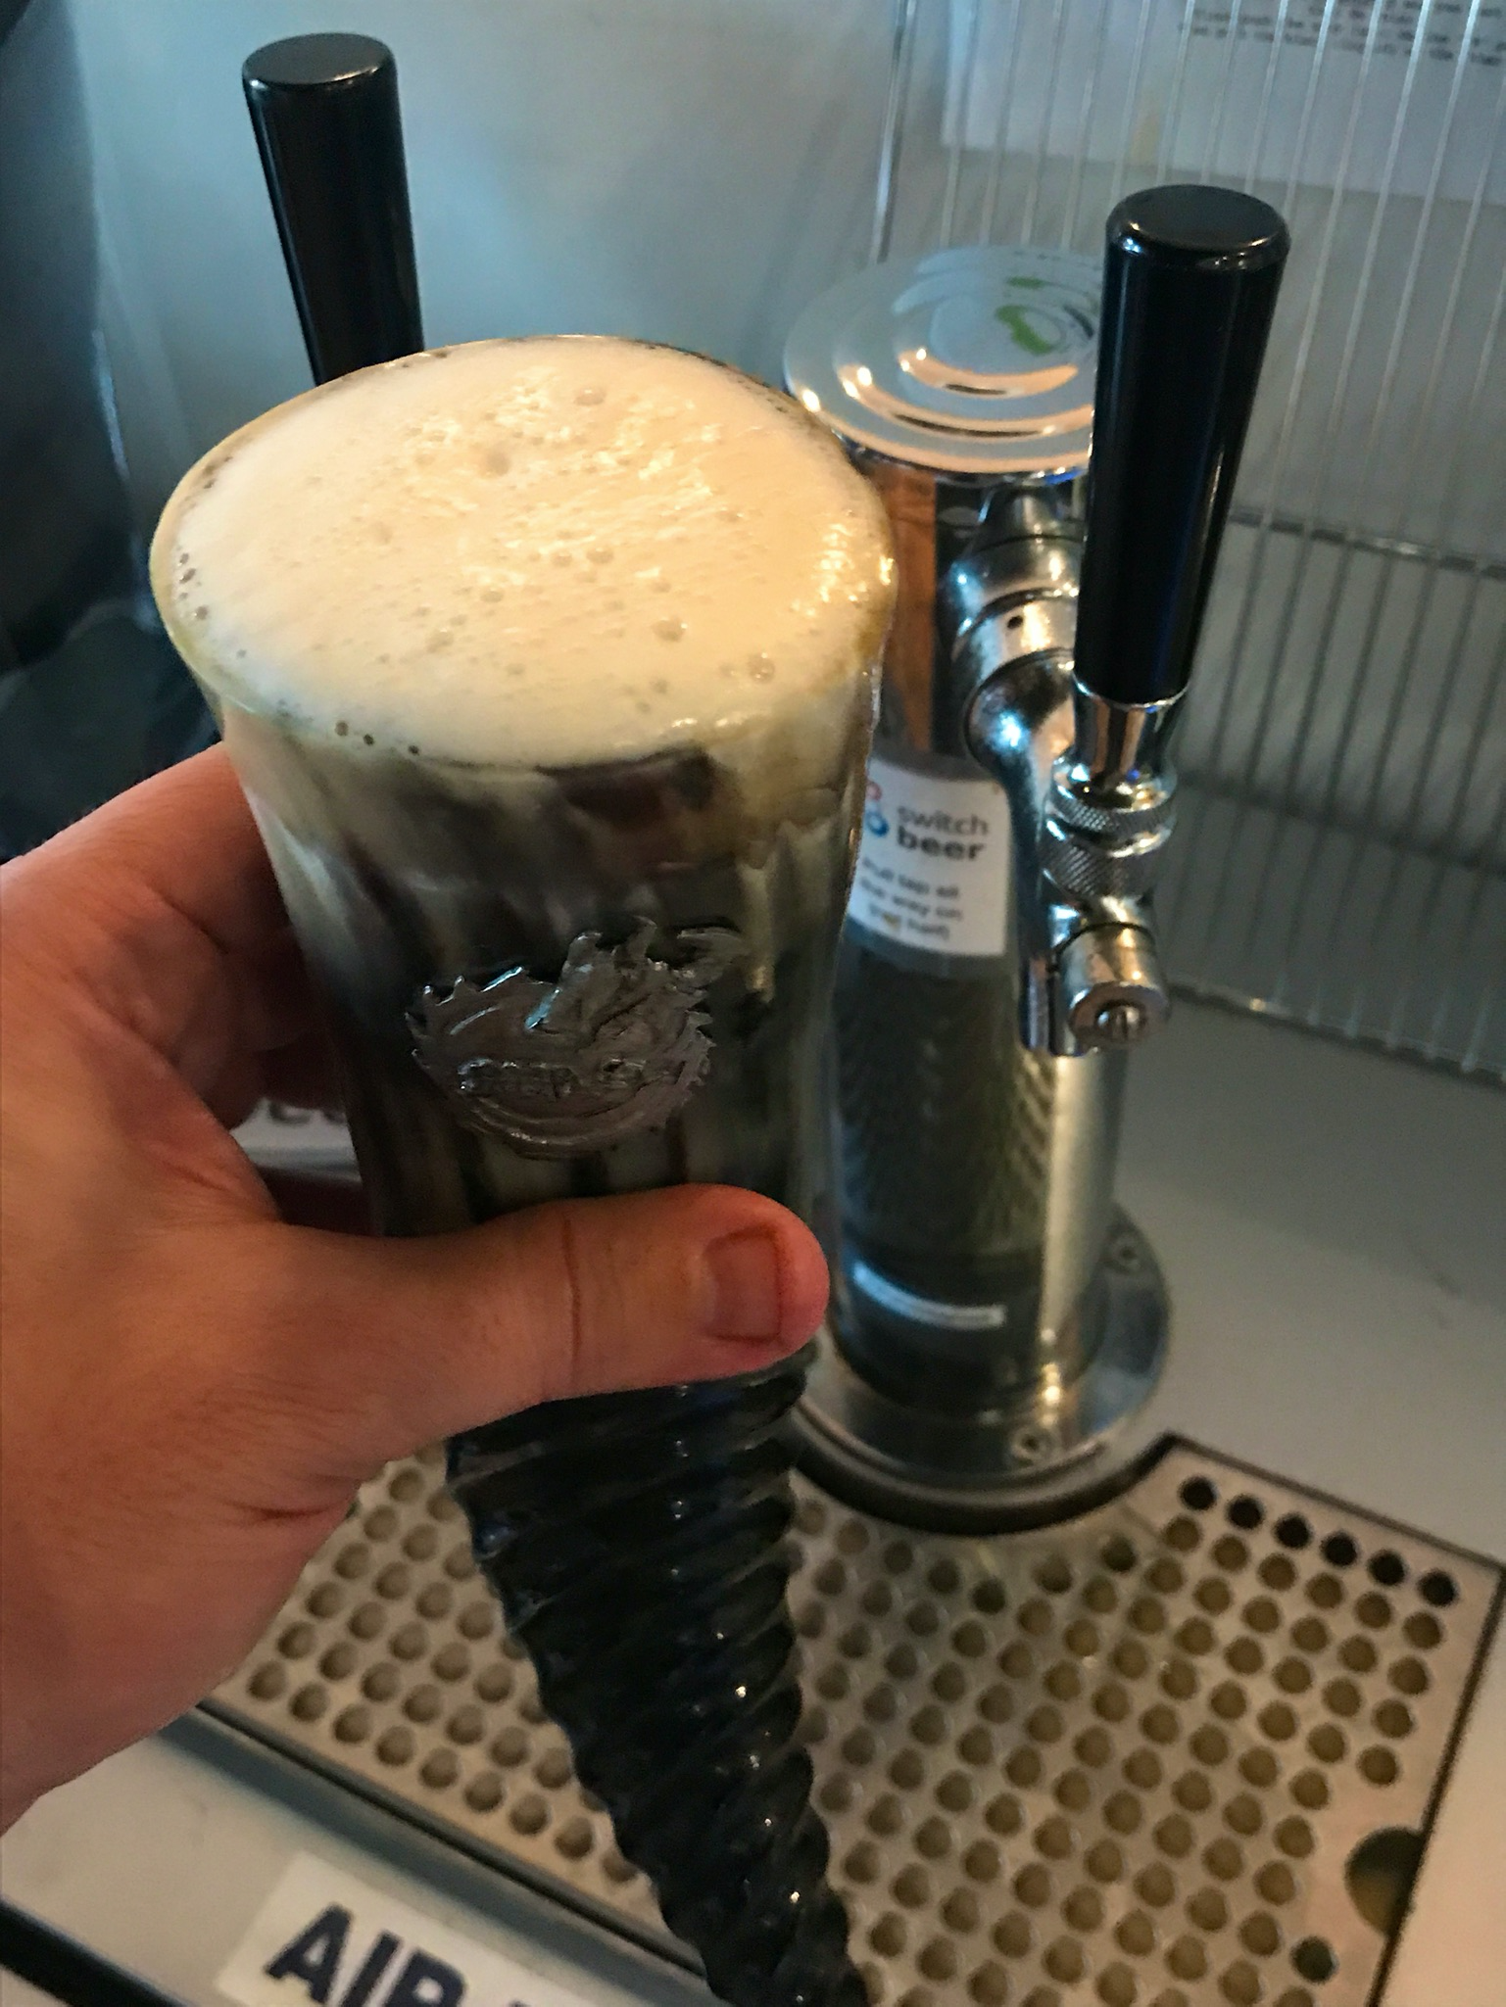
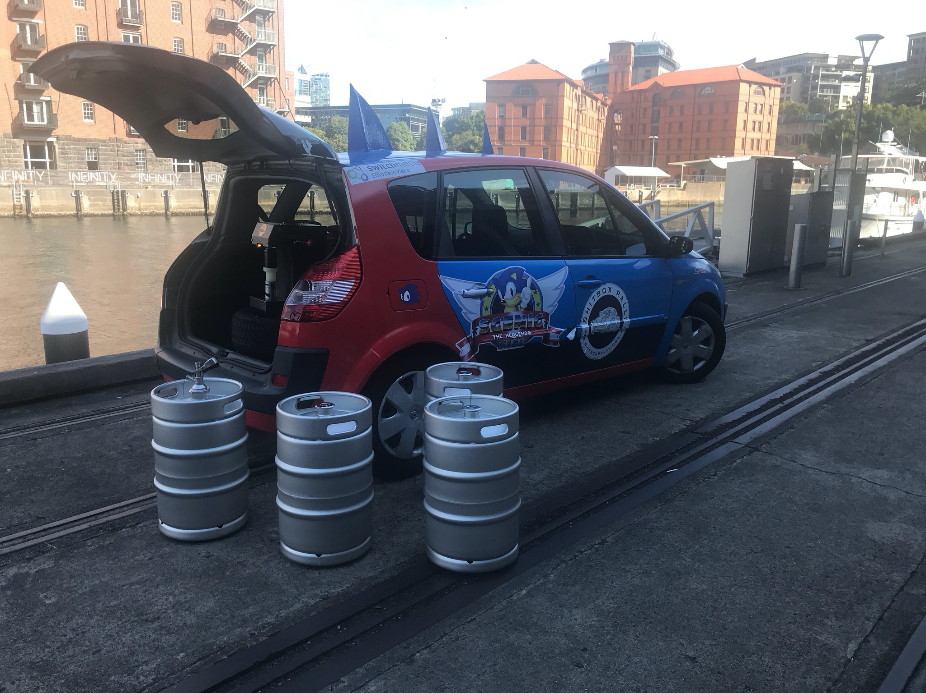
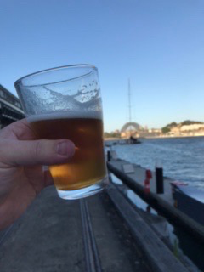
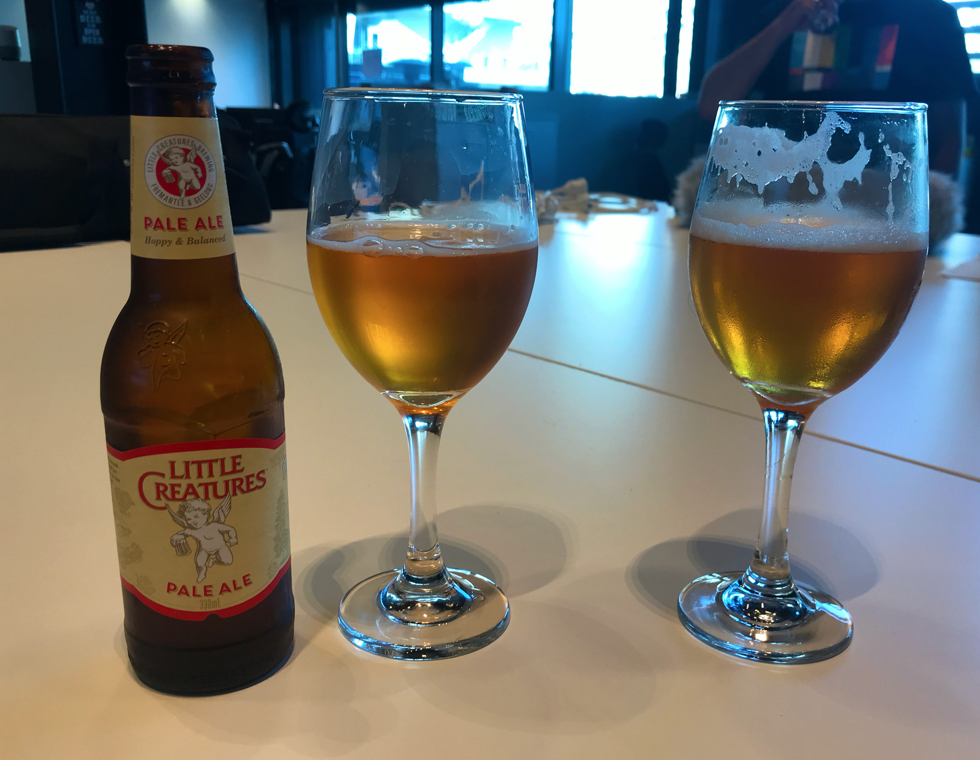
Step 6 - Waiting… Drink!
Hell Hole Helles
Ok, the best part!
(SwitchMedia office bar Jones Bay Wharf)
Purgatory Pale

Slide 22
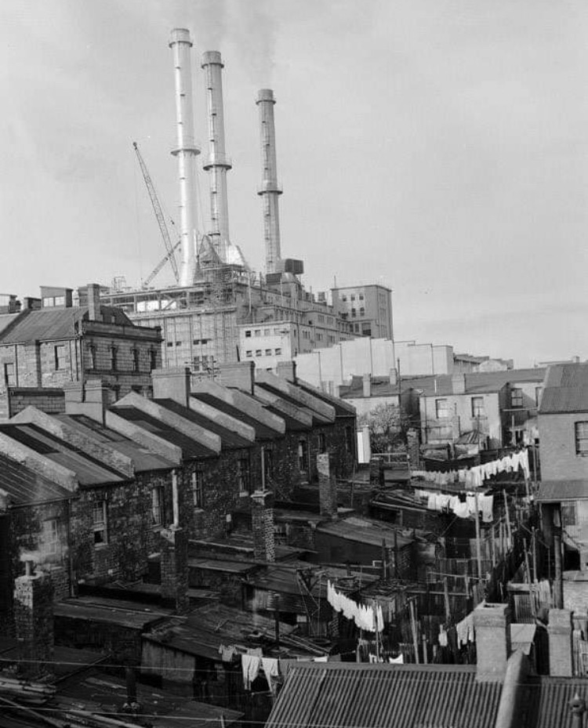
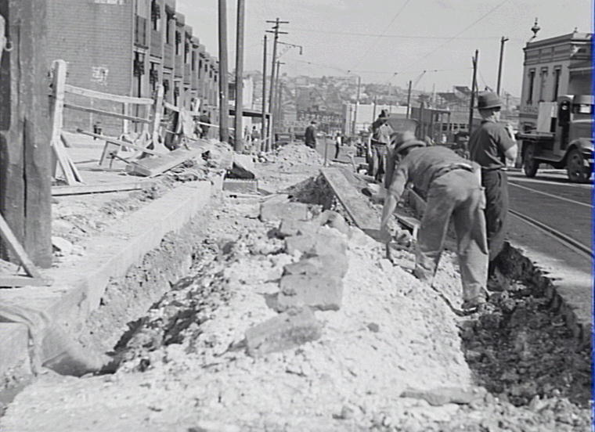
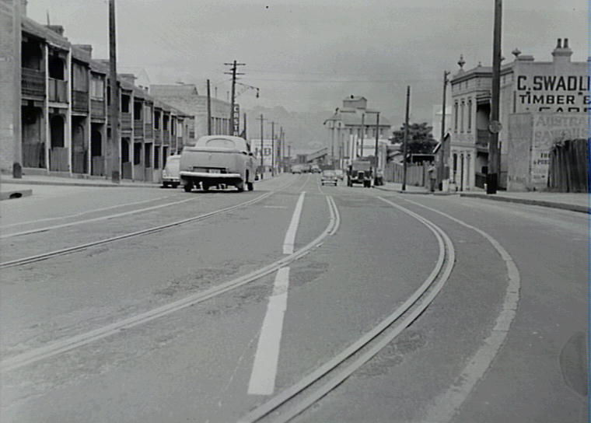
The Pyrmont Brewery history
(scenes of the Miller St brewery building)

Slide 23
James’ brews nothing like modern beer
I’m intrigued as to what Squire’s beer tasted like, most likely and warm flat English ale (Marris Otter like flavours from the Pioneer)
We know he charged 4d for a bottle - but I don’t see any estates in his name and legend has it he stole quite a lot of those ingredients
We might never know… but something to try

Slide 24

Thanks!
Pyrmont Beer soon in some Pyrmont pubs! (50L + 20L A-type kegs) + bottle shops (330ml cans) + corny kegs Expect the occasional growler refill, follow us on Facebook/Twitter kev@pyrmontbrewery.com.au

